Slide 1


CS202
Object-Oriented Programming
VISITOR
DESIGN PATTERN
24A02 - Group 3 - 1st pattern

Slide 2

CS202
Object-Oriented Programming
VISITOR DESIGN PATTERN
Motivation - An initial problem
The naïve solution
A new approach: Visitor
Structure of Visitor
Implementation
Pros and Cons
Real-world Application
Quiz

Slide 3
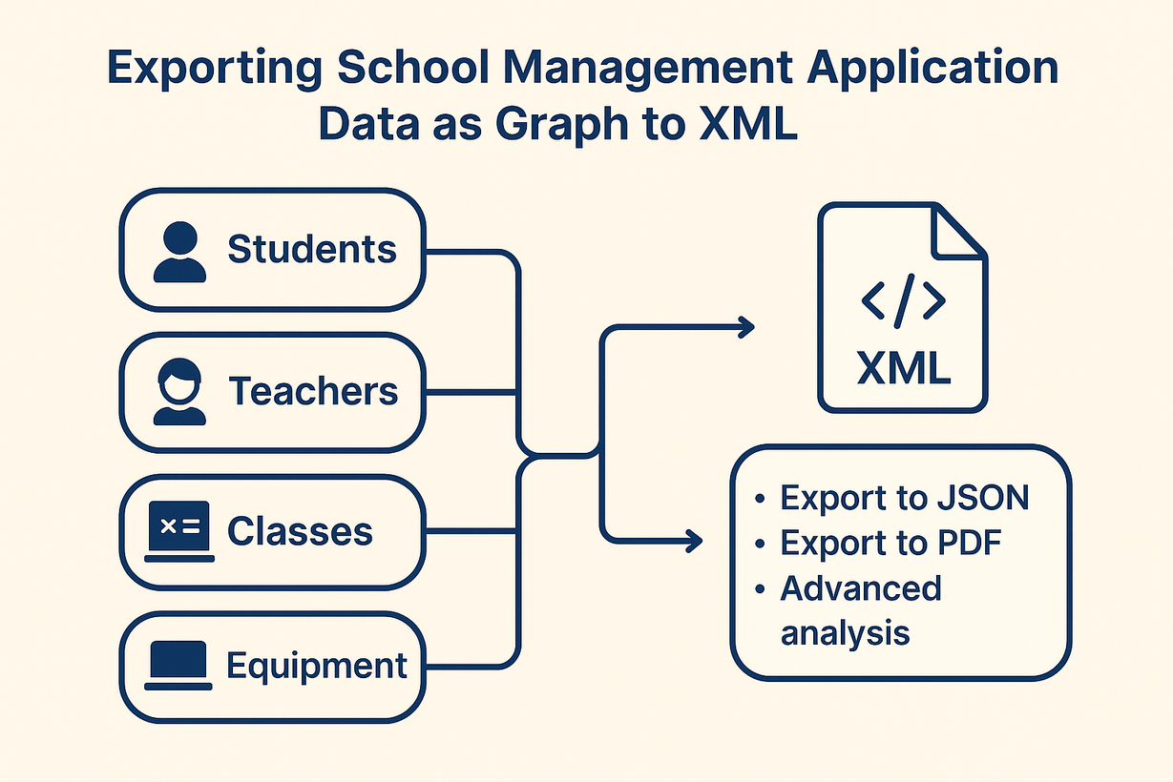
CS202
Object-Oriented Programming
Motivation: School Management App
Let’s assume you or your group is developing a school management application with various components such as students, teachers, classes, and equipment. The main function of the app is to:
Export the data of this graph to XML format.
In the future, potentially add export to JSON, PDF, or advanced analysis.

Slide 4

CS202
Object-Oriented Programming
Naïve Solution
Add the methods: exportToXML(), exportToJSON() and exportToPDF() methods to each node class (such as Classes, Teacher, Student) and use recursion to traverse the graph, calling these methods on each node
class Student{
public:
std::string toXML();
std::string toPDF();
std::string toJSON();
}

Slide 5



CS202
Object-Oriented Programming
Issues with this Solution
Violation of the Open/Closed Principle
Risk of Breaking Production Code
Inappropriate Responsibility

Slide 6
CS202
Object-Oriented Programming
Issues with this Solution
Each new requirement forces code changes, increasing the risk of errors in the product system.
Violation of the Open/Closed Principle

Slide 7
CS202
Object-Oriented Programming
Issues with this Solution
Violation of the Open/Closed Principle
Risk of Breaking Production Code
Inappropriate Responsibility

Slide 8
CS202
Object-Oriented Programming
Issues with this Solution
The node classes are already in production and modifications could introduce potential bugs.
Risk of Breaking Production Code

Slide 9
CS202
Object-Oriented Programming
Issues with this Solution
Violation of the Open/Closed Principle
Risk of Breaking Production Code
Inappropriate Responsibility

Slide 10
CS202
Object-Oriented Programming
Issues with this Solution
The code becomes harder to maintain and prone to logical errors due to a violation of the Single Responsibility Principle (each class should have only one responsibility; having multiple responsibilities makes maintenance difficult).
Inappropriate Responsibility

Slide 11
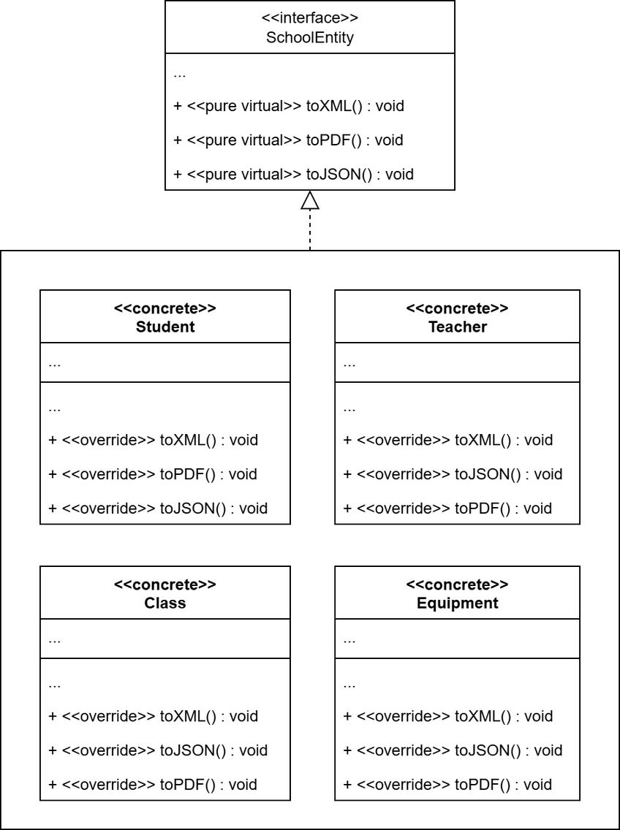
CS202
Object-Oriented Programming
Diagram of Naïve Solution
Violation of the Open/Closed Principle
Risk of Breaking Production Code
Inappropriate Responsibility

Slide 12

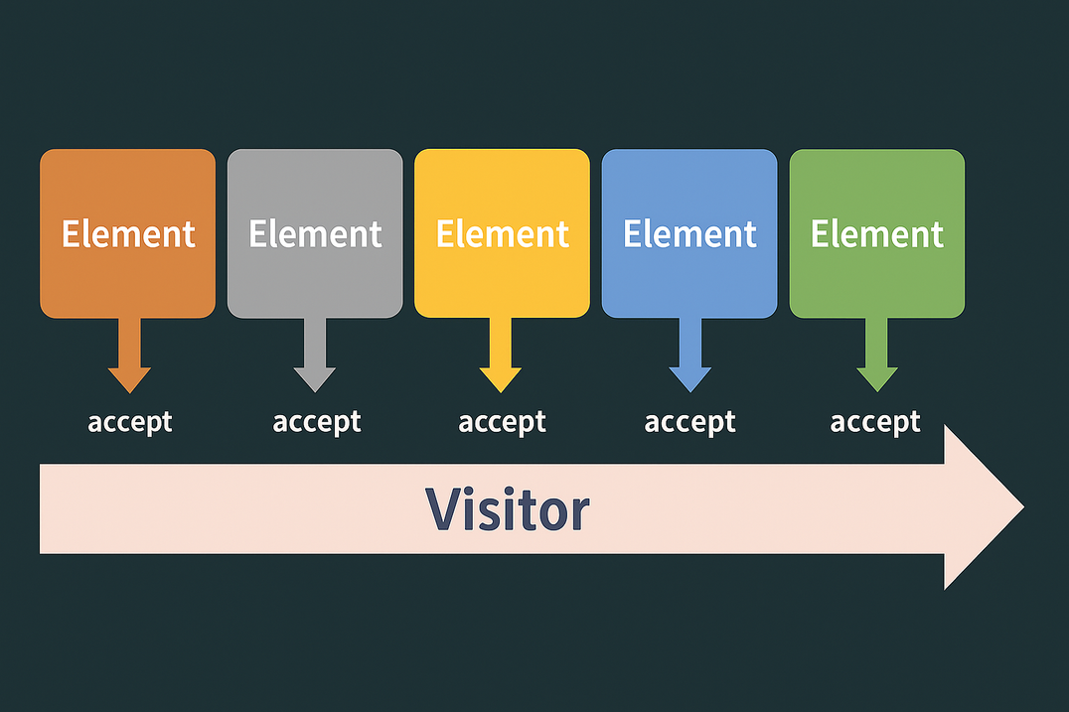
CS202
Object-Oriented Programming
New Approach: Visitor
In object-oriented design, the Visitor pattern is a design pattern that allows defining operations on a set of heterogeneous (in terms of type) objects without modifying the definitions of their classes.

Slide 13

CS202
Object-Oriented Programming
New Approach: Visitor
To achieve this, the Visitor pattern defines operations in separate classes called visitor classes, which enable the separation of operations from the objects they act upon. For each new operation added, a corresponding visitor class is created.

Slide 14



CS202
Object-Oriented Programming
Visitor Classes
Structure of the
VISITOR
Design Pattern
Classes of objects
in the object collection
The Client

Slide 15
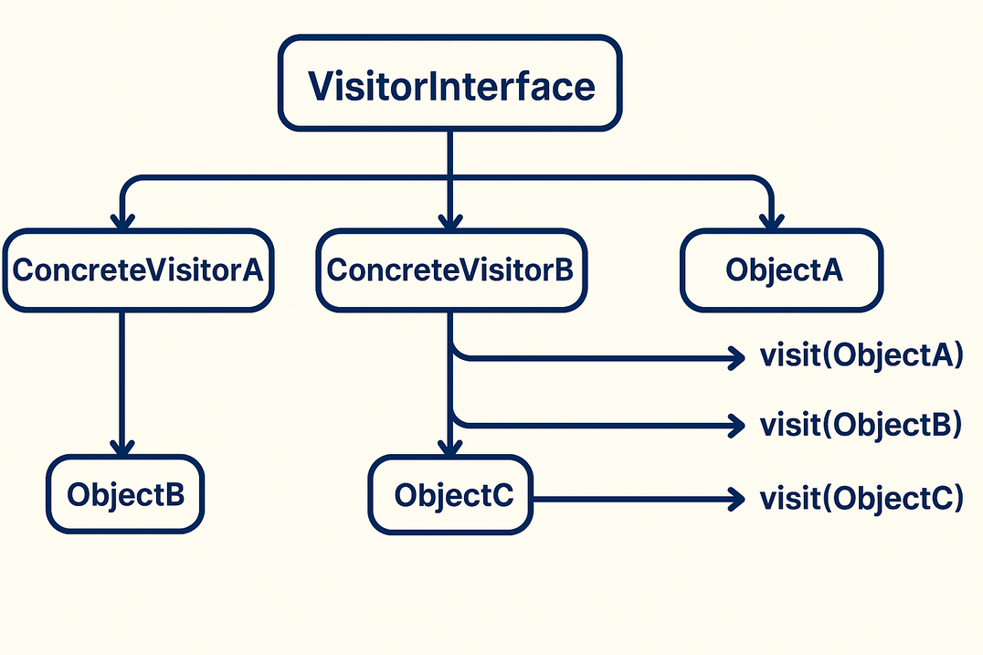
CS202
Object-Oriented Programming
Visitor Classes
Visitor classes handle operations that work with objects. They all follow a shared interface named “VisitorInterface” which includes methods like “visit( ObjectType object) ”
For each object type, there's a corresponding “visit” method to process that specific type.

Slide 16
CS202
Object-Oriented Programming
Visitor Classes
ExampleVisitorClass.h
ExampleVisitorClass.h
class Visitor {
public:
virtual void visitClass(Class* c) = 0;
virtual void visitStudent(Student* s) = 0;
virtual void visitTeacher(Teacher* t) = 0;
virtual void visitEquipment(Equipment* e) = 0;
virtual ~Visitor() = default;
};
class XMLExportVisitor : public Visitor {
public:
void visitClass(Class* c) override;
void visitStudent(Student* s) override;
void visitTeacher(Teacher* t) override;
void visitEquipment(Equipment* e) override;
}

Slide 17
CS202
Object-Oriented Programming
Visitor Classes
Structure of the
VISITOR
Design Pattern
Classes of objects
in the object collection
The Client

Slide 18
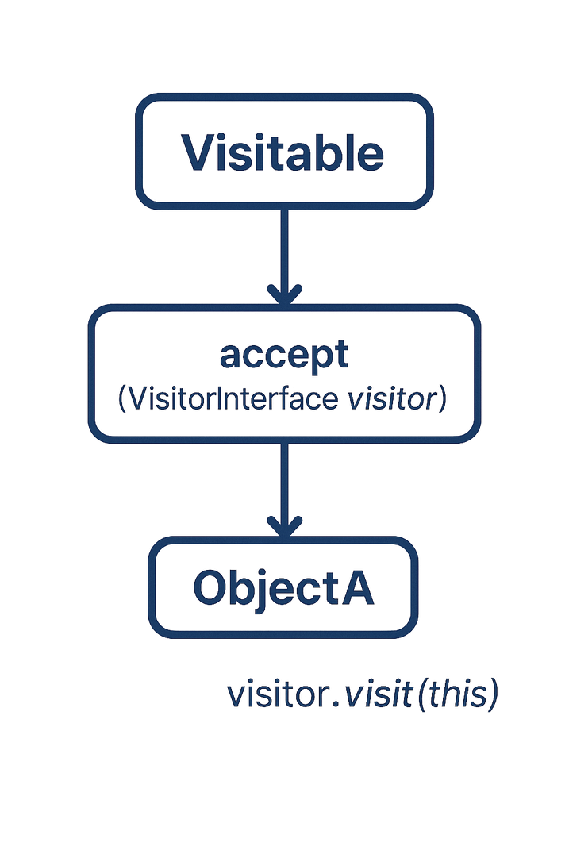
CS202
Object-Oriented Programming
Classes of objects
in the object collection
For the operations defined in the visitor classes to be executed, the classes of the objects in the collection must implement the “Visitable” interface, which includes a method: “accept(VisitorInterface visitor)”
In the implementation of this method, the visitor's “visit” method is called with the calling object itself passed as the parameter.

Slide 19
CS202
Object-Oriented Programming
Classes of objects
in the object collection
ExampleObjectClass.cpp
void Student::accept(Visitor* v) {
v->visitStudent(this);
}
void Teacher::accept(Visitor* v) {
v->visitTeacher(this);
}
void Equipment::accept(Visitor* v) {
v->visitEquipment(this);
}
void Class::accept(Visitor* v) {
v->visitClass(this);
}

Slide 20
CS202
Object-Oriented Programming
Visitor Classes
Structure of the
VISITOR
Design Pattern
Classes of objects
in the object collection
The Client

Slide 21
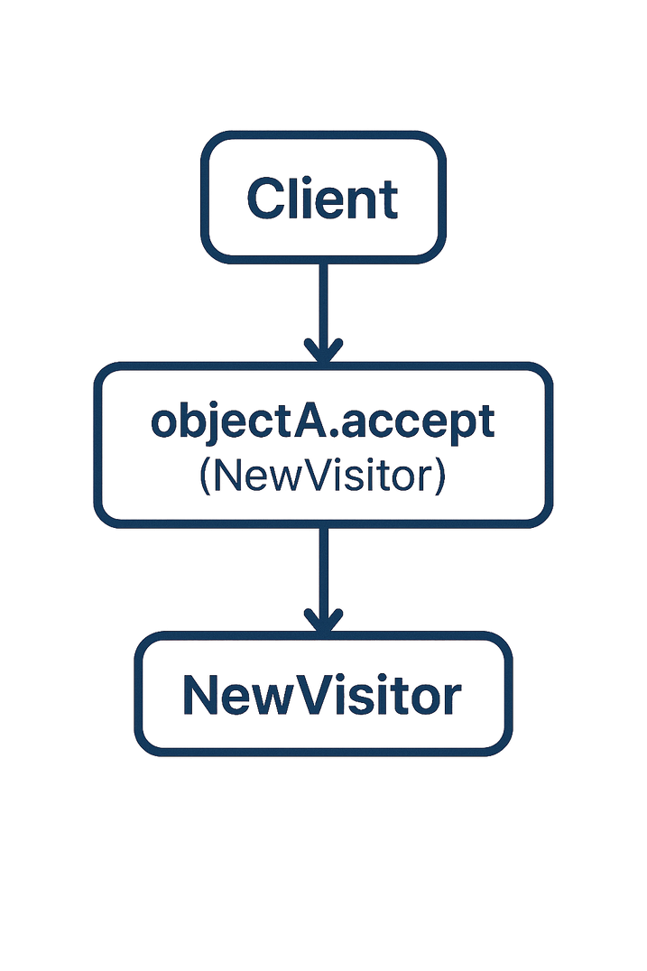
CS202
Object-Oriented Programming
The Client
The Client is the component responsible for organizing and coordinating the use of the Visitor to perform operations on the Objects .
The Client acts as the "user" of the design pattern, ensuring that the Objects and the Visitor are properly connected to execute the desired functionalities.

Slide 22
CS202
The Client
ExampleTheClient.cpp
ExampleMain.cpp
class Application
{
private:
std::vector<SchoolEntity*> entities;
public:
...
void addEntity(SchoolEntity* entity);
void exportToXML();
}
int main() {
Application schoolApp;
Class* scienceClass = new Class("Science 101");
Student* student1 = new Student("S1001", "Alice");
Teacher* teacher1 = new Teacher("T2001", "Physics");
Equipment* microscope = new Equipment("E3001", "HPMicro");
scienceClass->addMember(student1);
scienceClass->addMember(teacher1);
scienceClass->addMember(microscope);
schoolApp.addEntity(scienceClass);
schoolApp.exportToXML();
....
}

Slide 23
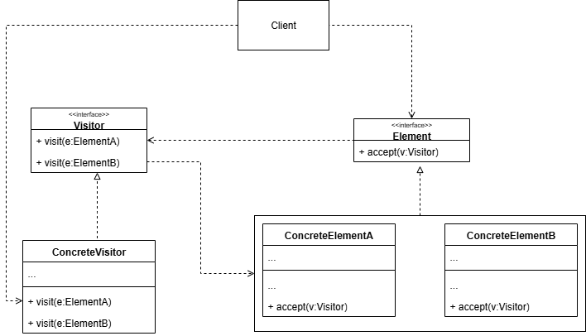

A General Class Diagram

Slide 24
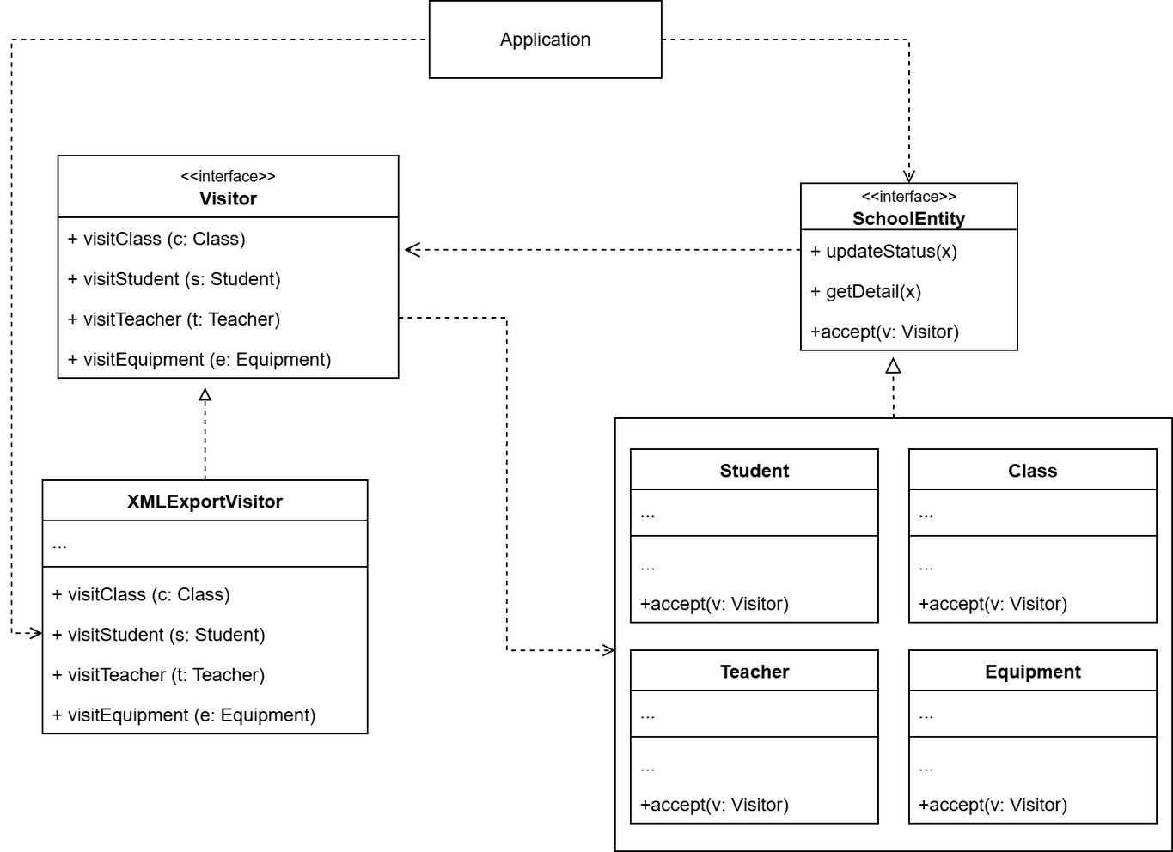
Diagram for the problem

Slide 25
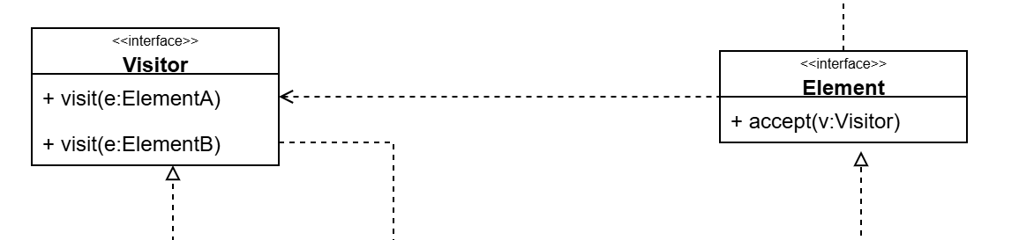
CS202
Object-Oriented Programming
Implementation
1
Declare the visitor interface with a set of “visiting” methods, one per each concreate element class that exists in the program.

Slide 26
CS202
Object-Oriented Programming
Implementation
2
Declare the element interface. If you’re working with an existing element class hierarchy, add the abstract “accept” method to the base class of the hierarchy.

Slide 27
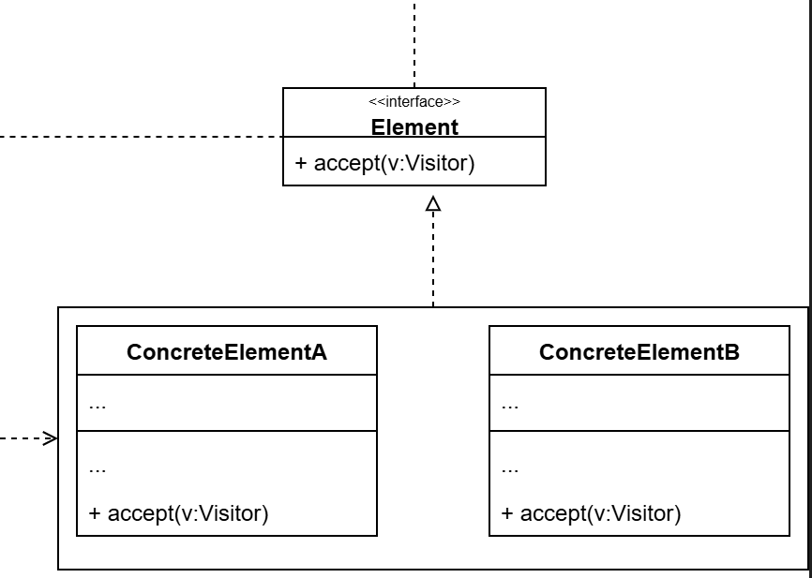
CS202
Object-Oriented Programming
Implementation
3
Implement the accept methods in all concrete element classes. These methods must simply redirect the call to a visiting method on the incoming visitor object which matches the class of the current element.

Slide 28
CS202
Object-Oriented Programming
Implementation
4
The element classes should only work with visitors via the visitor interface. Visitors, however, must be aware of all concrete element classes, referenced as parameter types of the visiting method.

Slide 29

CS202
Object-Oriented Programming
Implementation
5
For each behavior that can’t be implemented inside the element hierarchy, create a new concrete visitor class and implement all of the visiting methods.
6
The client must create visitor objects and pass them into elements via “accept” methods.

Slide 30

CS202
Object-Oriented Programming
PROS
Cons

Slide 31




CS202
Open/Closed Principle: You can introduce a new behavior that can work with objects of different classes without changing these classes.
PROS
Single Responsibility Principle: You can move multiple versions of the same behavior into the same class.
A visitor object can accumulate some useful information while working with various objects => handy when you want to traverse some complex object structure.

Slide 32
CS202
Object-Oriented Programming
PROS
CONS

Slide 33

CS202
Object-Oriented Programming
You need to update all visitors each time a class gets added to or removed from the element hierarchy.
CONS
Visitors might lack the necessary access to the private fields and methods of the elements that they’re supposed to work with

Slide 34

CS202
Object-Oriented Programming
Real-World Applications

Slide 35

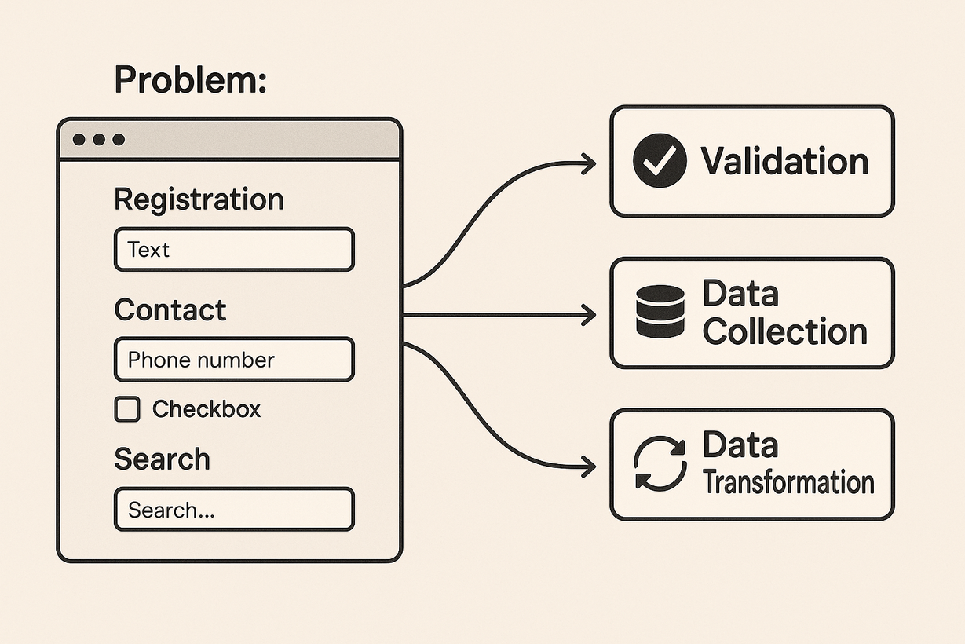
CS202
Object-Oriented Programming
Web Development:
Form Data Analysis and Processing
Problem: You have various types of forms on a website . Each form contains different data fields. You need to perform different operations on the data submitted through these forms, such as:
Validation: Checking if the entered data meets specific criteria.
Data Collection: Extracting all the submitted values to send to the server.
Data Transformation: Converting data formats (e.g., date conversions).

Slide 36
CS202
Object-Oriented Programming
Web Development:
Form Data Analysis and Processing
How Visitor is Applied:
The form elements (input text fields, select boxes, checkboxes, etc.) can be considered the "Elements".
Each operation (validation, collection, transformation) becomes a "Visitor". Each visitor knows how to "visit" and perform its specific task on each type of form element.
When you want to validate a form, you would traverse the form's elements and have each element "accept" the validation visitor. The visitor then applies the relevant validation rules for that type of field.

Slide 37
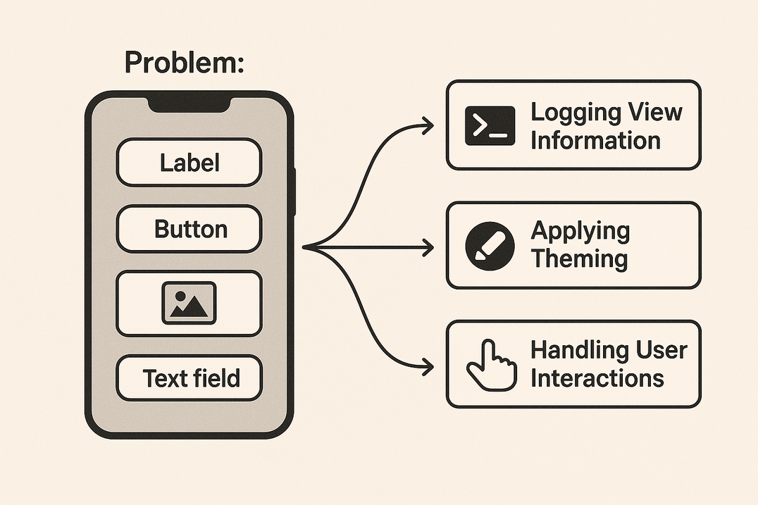
CS202
Object-Oriented Programming
Mobile Development: Rendering and Interacting with Diverse UI Elements
Problem: In mobile apps, you have a hierarchy of different UI elements. You might need to perform different actions on these elements, such as:
Logging View Information: Printing details about each view (type, content, position).
Change theme: Consistently changing colors, fonts, and sizes across relevant UI elements.
Handling User Interactions: Setting up actions that occur when a user interacts with an element (e.g., tapping a button).

Slide 38
CS202
Object-Oriented Programming
Mobile Development: Rendering and Interacting with Diverse UI Elements
How Visitor is Applied:
The UI views (buttons, labels, image views, text fields, etc.) are the "Elements".
Each action (logging, theming, event handling setup) is a "Visitor". Each visitor defines how it "visits" and acts upon each type of view.
To log the entire UI hierarchy, you would traverse the view tree and each view would "accept" the logging visitor. This visitor would then print the appropriate information based on the view's type.

Slide 39
CS202
Object-Oriented Programming
Quiz

Slide 40
CS202
Object-Oriented Programming
a) When you need to create objects with complex structures
b) When you want to add new operations without modifying the object classes
When is the Visitor Pattern typically used?
c) When you need to manage system resources
d) When you want to hide the implementation details of a class

Slide 41
CS202
Object-Oriented Programming
a) When you need to create objects with complex structures
b) When you want to add new operations without modifying the object classes
When is the Visitor Pattern typically used?
c) When you need to manage system resources
d) When you want to hide the implementation details of a class

Slide 42
CS202
Object-Oriented Programming
a) To create new objects flexibly
b) To separate algorithms from the object structure
What is the main purpose of the Visitor Pattern?
c) To combine classes with similar structures
d) To manage the lifecycle of an object

Slide 43
CS202
Object-Oriented Programming
a) To create new objects flexibly
b) To separate algorithms from the object structure
What is the main purpose of the Visitor Pattern?
c) To combine classes with similar structures
d) To manage the lifecycle of an object

Slide 44
CS202
Object-Oriented Programming
a) visit(visitor)
Which method in the Visitor Pattern is typically called by Element classes to accept a Visitor?
b) accept(visitor)
c) execute(visitor)
d) perform(visitor)

Slide 45
CS202
Object-Oriented Programming
a) visit(visitor)
Which method in the Visitor Pattern is typically called by Element classes to accept a Visitor?
b) accept(visitor)
c) execute(visitor)
d) perform(visitor)

Slide 46
CS202
Object-Oriented Programming
a) Element
In the Visitor Pattern, which component is responsible for defining the interface for operations performed on elements?
b) Visitor
c) ConcreteElement
d) ObjectStructure

Slide 47
CS202
Object-Oriented Programming
a) Element
In the Visitor Pattern, which component is responsible for defining the interface for operations performed on elements?
b) Visitor
c) ConcreteElement
d) ObjectStructure

Slide 48
CS202
Object-Oriented Programming
a) Inheritance and Polymorphism
In C++, which OOP feature is commonly used to implement the Visitor Pattern?
b) Encapsulation
c) Abstraction
d) Composition

Slide 49
CS202
Object-Oriented Programming
a) Inheritance and Polymorphism
In C++, which OOP feature is commonly used to implement the Visitor Pattern?
b) Encapsulation
c) Abstraction
d) Composition

Slide 50



CS202
Object-Oriented Programming
Thank You

